Slide 1

Transportation and Warehousing

Slide 2
Table of contents
A
B
C
D
E
Introduction
Building the portfolio
Portfolio analysis
Conclusion
Portfolio optimization

Slide 3
A
Introduction

Slide 4
A. Introduction
Data Source: 01/01/2019-03/24/2023
Money CNN (list transporting + warehousing market cap),
Yahoo Finance (import data)
Transporting sub-sectors: Air Freight/Couriers, Airlines, Marine Shipping, Railroads and Trucking
Warehousing

Slide 5
B
Building the portfolio

Slide 6
B. Building the portfolio
Method: Base on market cap
Market instability
Social media influence
Pandemic-related disruption
Economic uncertainty
-> Investing in penny stocks can be challenging, particularly in the current economy and regulatory environment.

Slide 7
B. Building the portfolio
Method of choosing stock:
Take top 5 stocks that have the highest market capitalization
Stocks whose correlation is less than 0.6 will be kept, to ensure the diversity of the portfolio.
In the case of stocks in highly correlated sub-sectors, we take the stock with the highest market cap

Slide 8
B. Building the portfolio
1. Take highest market cap stocks
Transportation
Airlines
Trucking
Air-Fright Courier
Marine
Shipping
Railroad
PHIG
DAL
ALK
AAL
LUV
ODFL
JBHT
KNX
SAIA
LSTR
UPS
FDX
EXPD
CHRW
GXO
KEX
INSW
MATX
TDW
LPG
UNP
CSX
NSC
GATX
AWRY
Warehousing
DPW.DE
R
CEVA
COLD
ILPT

Slide 9

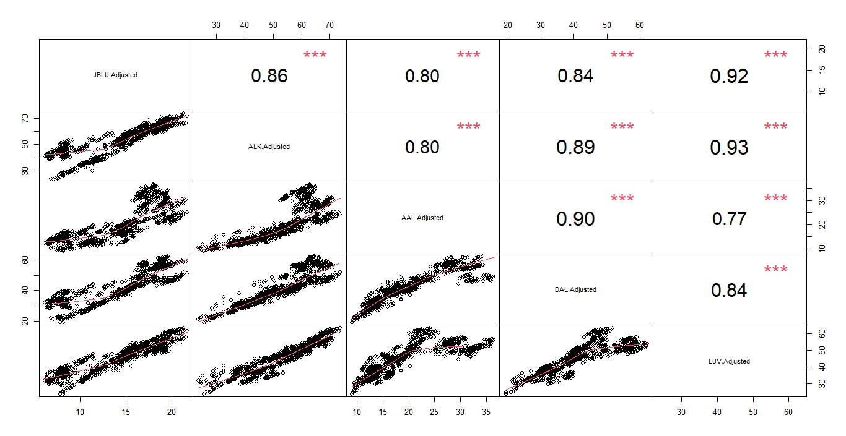
D. Portfolio optimization
Airlines correlation matrix

Slide 10
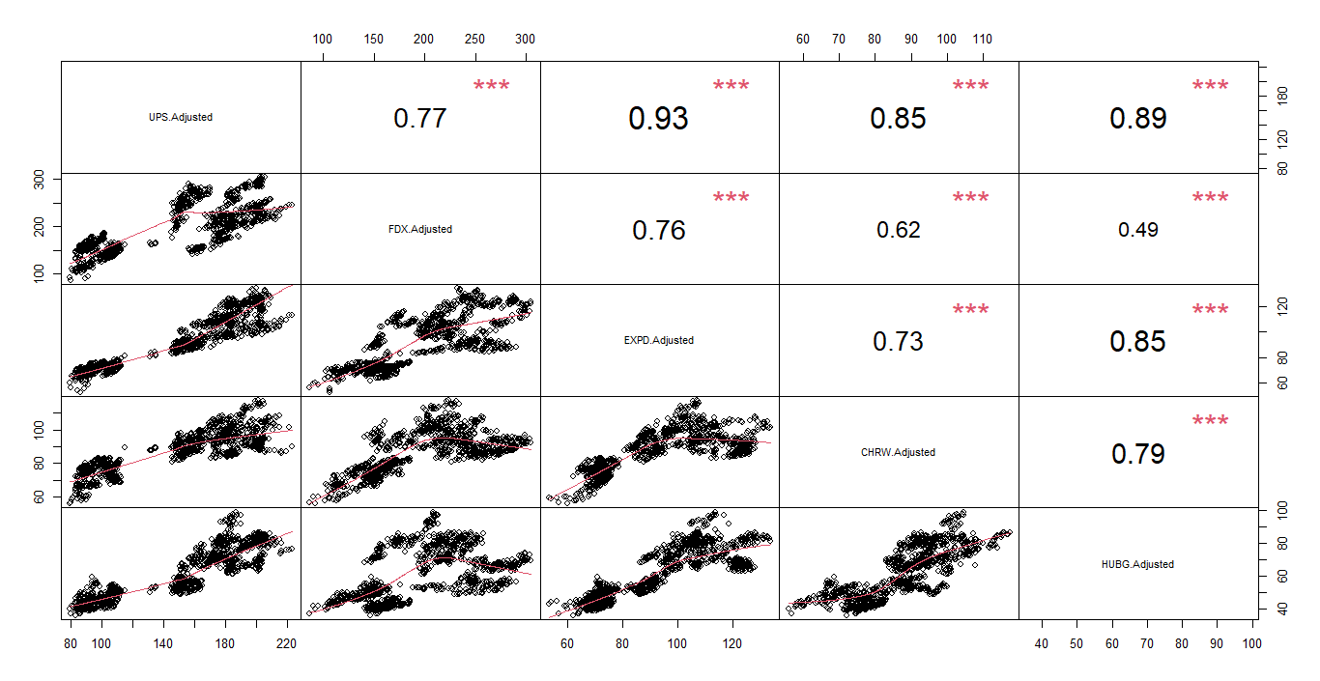
D. Portfolio optimization
Air Freight/ Couriers correlation matrix

Slide 11
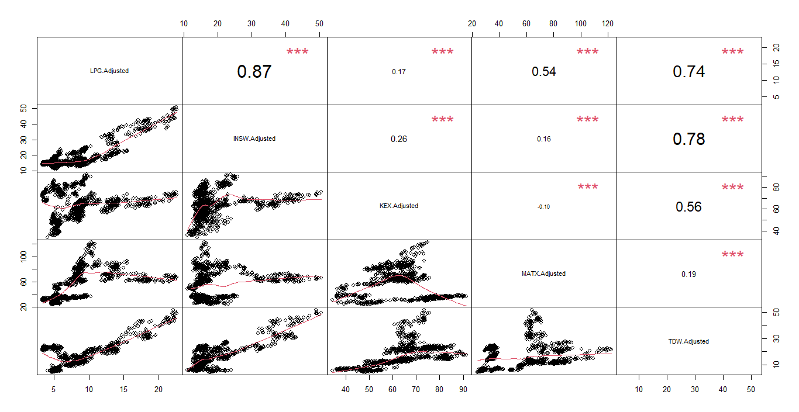
D. Portfolio optimization
Marine Shipping correlation matrix

Slide 12
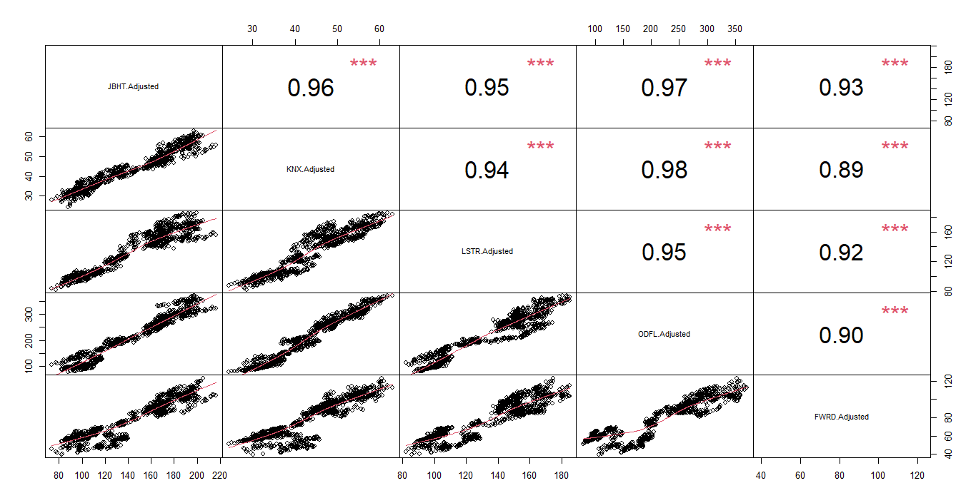
D. Portfolio optimization
Trucking correlation matrix

Slide 13
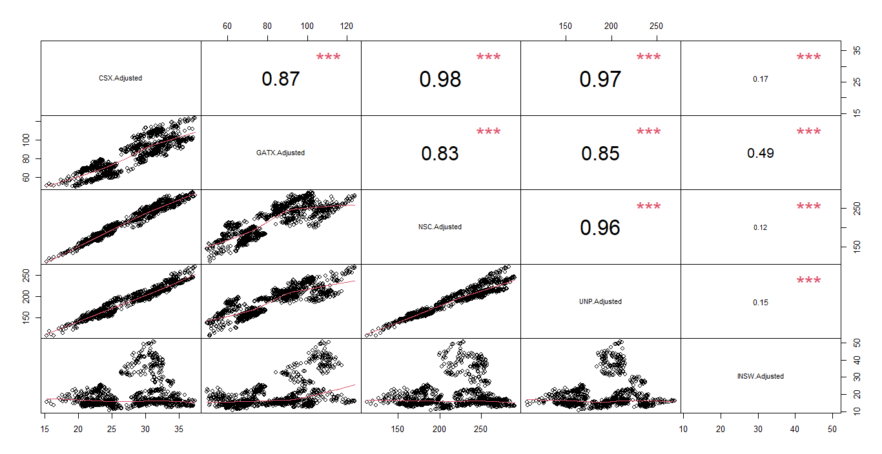
D. Portfolio optimization
Railroads correlation matrix

Slide 14
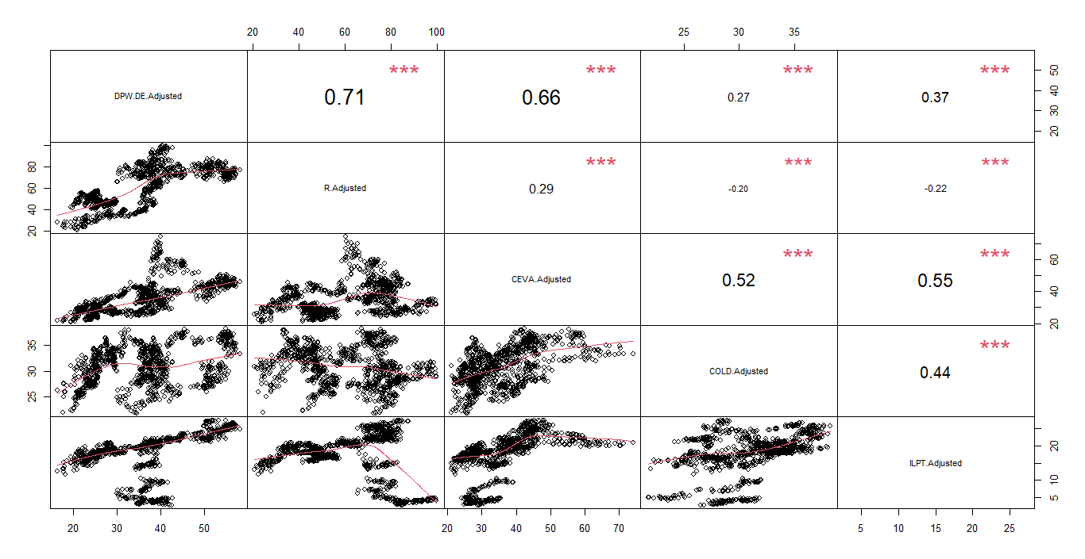
D. Portfolio optimization
Warehousing correlation matrix

Slide 15
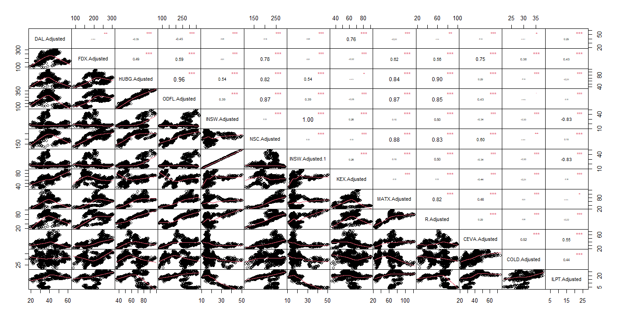
D. Portfolio optimization
Total ticker correlation matrix

Slide 16
B. Building the portfolio
Transportation
Airlines
Trucking
Air-Fright Courier
Marine
Shipping
Railroad
PHIG
DAL
ALK
AAL
LUV
ODFL
JBHT
KNX
SAIA
LSTR
UPS
FDX
EXPD
CHRW
GXO
KEX
INSW
MATX
TDW
LPG
UNP
CSX
NSC
GATX
AWRY
Warehousing
DPW.DE
R
CEVA
COLD
ILPT

Slide 17
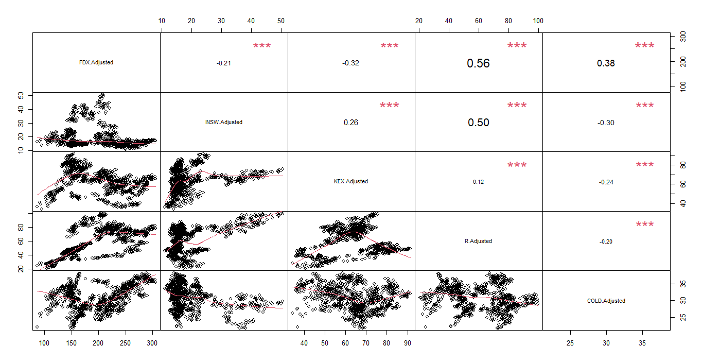
D. Portfolio optimization
Final ticker correlation matrix

Slide 18
C
Portfolio analysis

Slide 19
C. Portfolio analysis
1. Chart Series analysis
The relative strength index (RSI) measures the speed and magnitude of a security's recent price changes to evaluate overvalued or undervalued conditions in the price of that security.
SMA(Simple Moving Average) often used to determine trend direction.
SMAs are commonly used to smooth price data and technical indicators

Slide 20
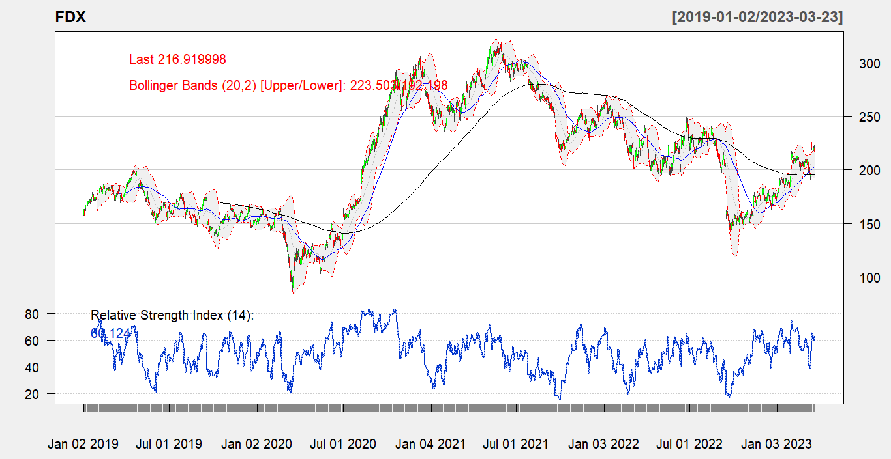
D. Portfolio optimization

Slide 21
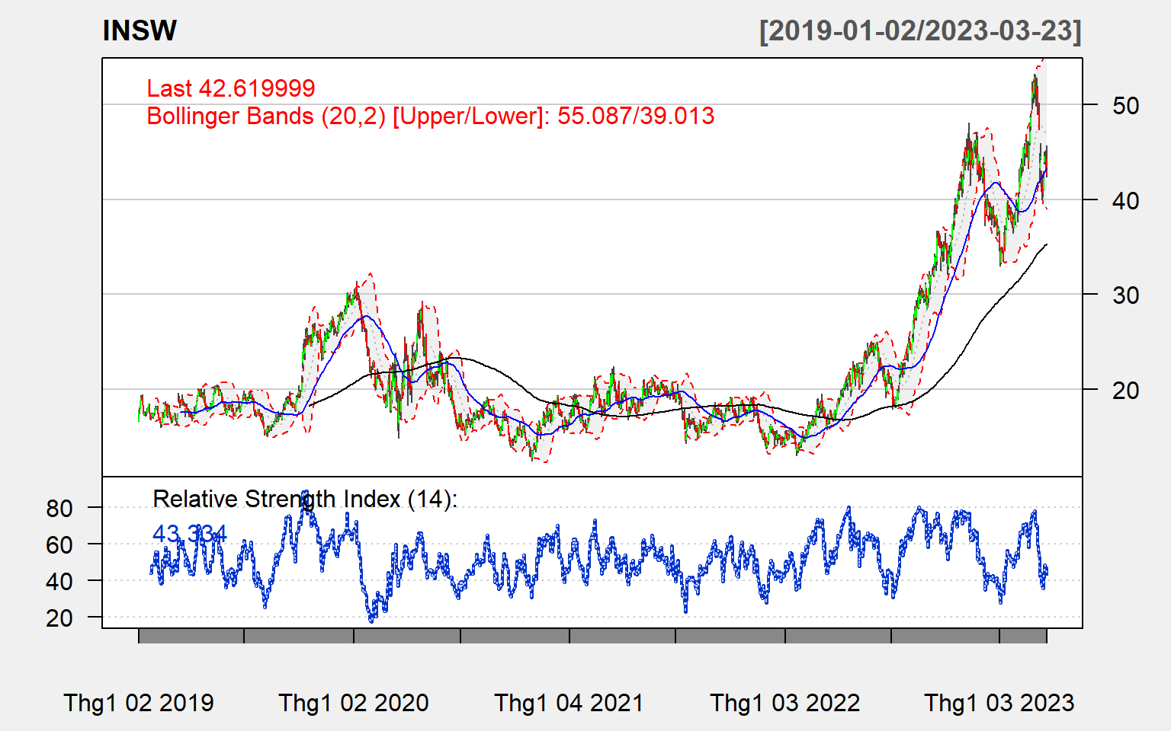
D. Portfolio optimization

Slide 22
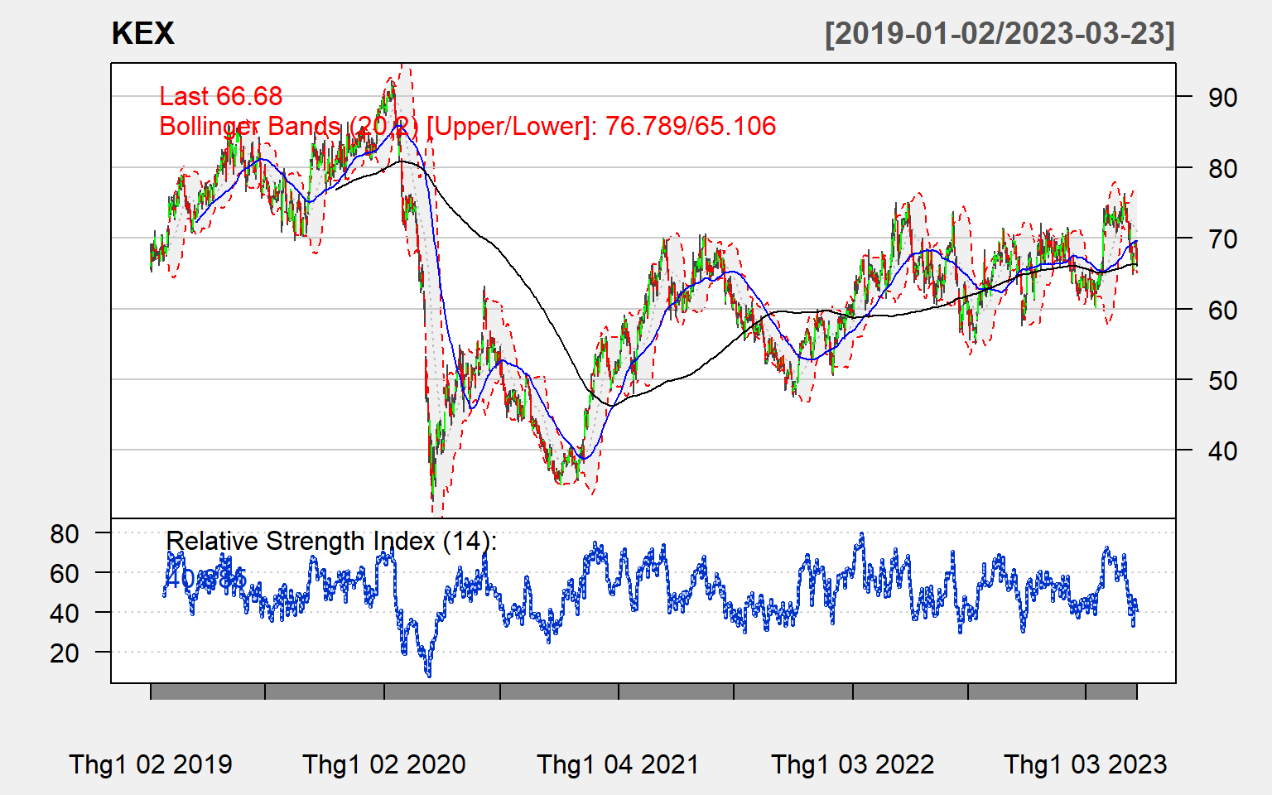
D. Portfolio optimization

Slide 23
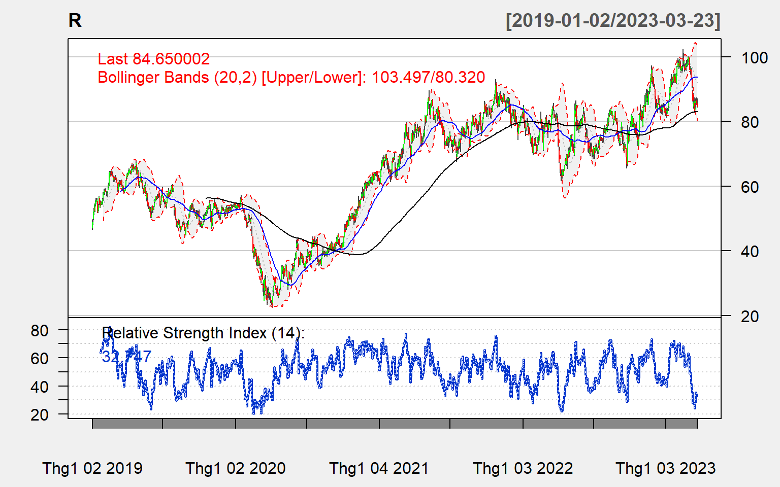
D. Portfolio optimization

Slide 24
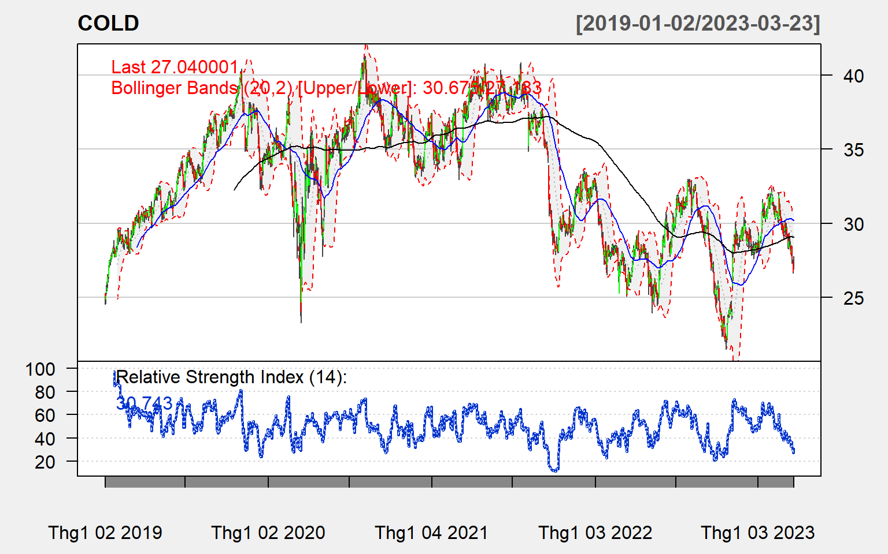
D. Portfolio optimization

Slide 25
C. Portfolio analysis
1. ChartSeries analysis
2. Descriptive Statistic
a, Statistics for adjusted price

Slide 26
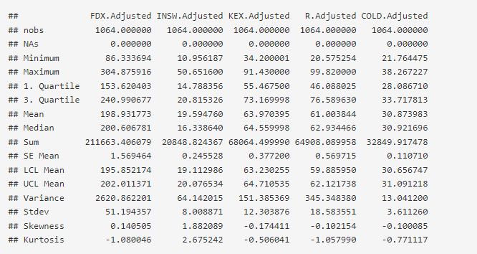

Slide 27
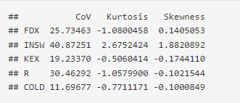

Slide 28
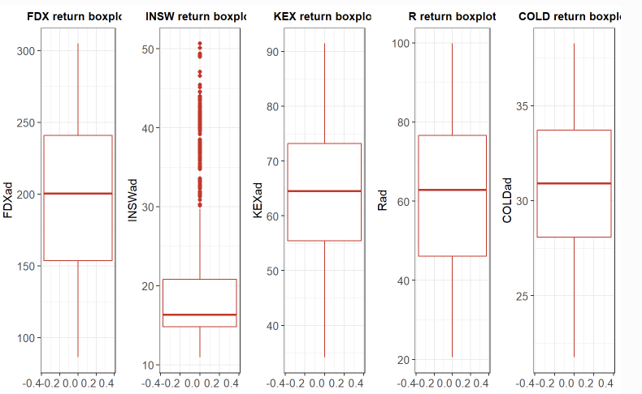

Slide 29
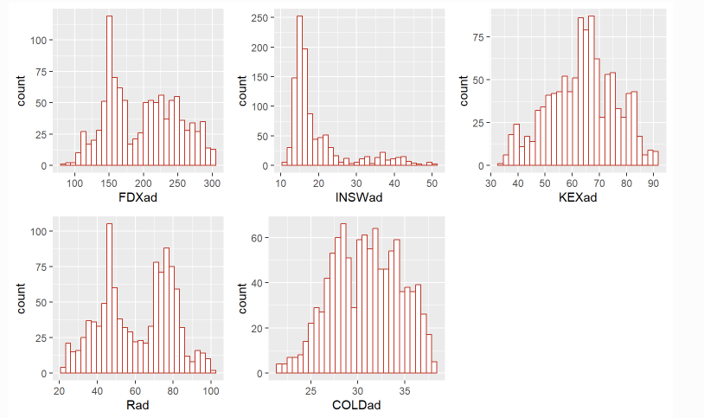

Slide 30
C. Portfolio analysis
1. Exploration data analysis
2. Descriptive Statistic
a, Statistics for adjusted price
b, Cumulative daily return

Slide 31
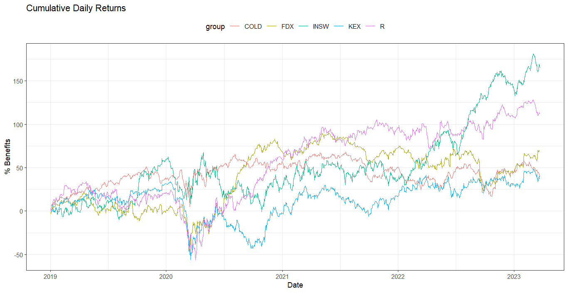
D. Portfolio optimization

Slide 32
D
Portfolio optimization

Slide 33
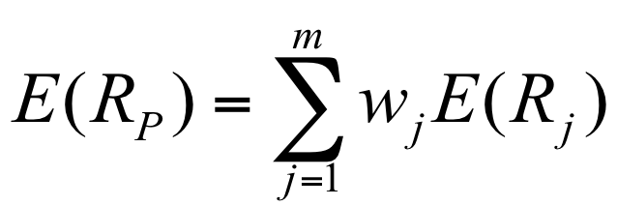
D. Portfolio optimization
Consider the case of investment, not counting the case of selling stocks
Focus on 3 indicators: risk, weight, return.
All of these component will be illustrate by pie chart

Slide 34
D. Portfolio optimization
1. Feasible Portfolio
A feasible portfolio is an ‘existing’ portfolio described by the settings of the portfolio specification.
We calculate with equally weighted stocks
Target return: 0.0359
Target risk: 1.8754
 | FDX | INSW | KEX | R | COLD
Weights | 0.2 | 0.2 | 0.2 | 0.2 | 0.2
Covariance | 0.1893 | 0.2343 | 0.2316 | 0.2255 | 0.1194

Slide 35
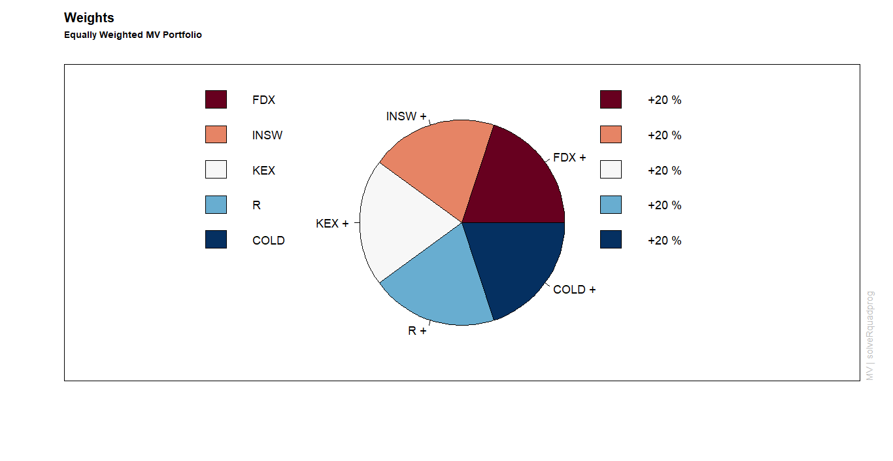
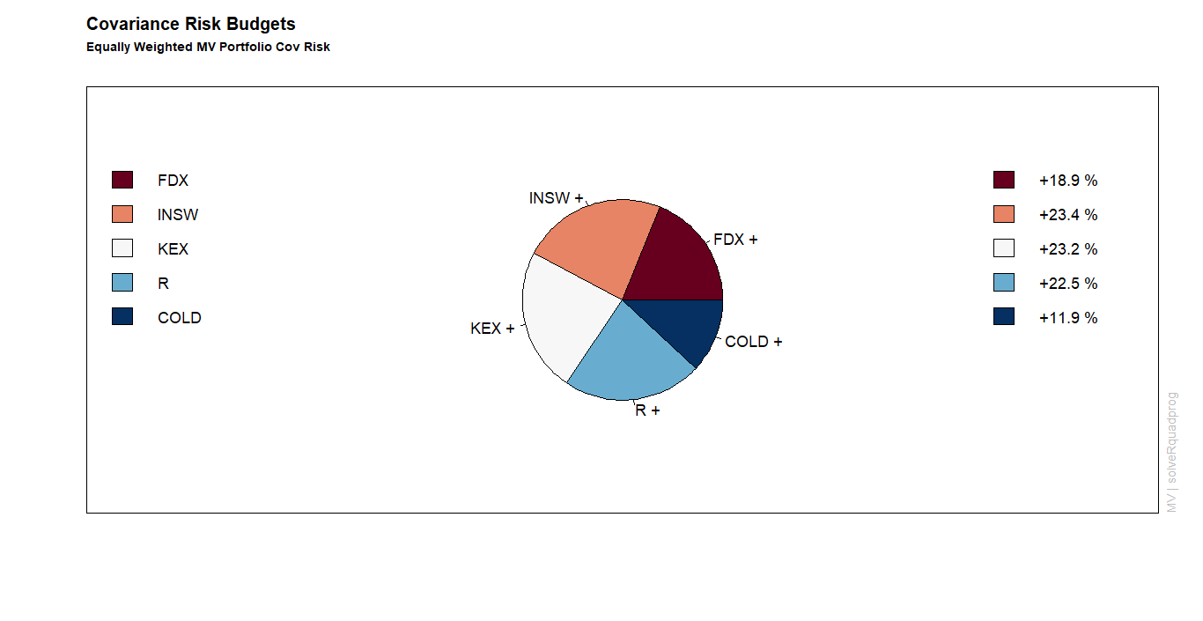
D. Portfolio optimization

Slide 36
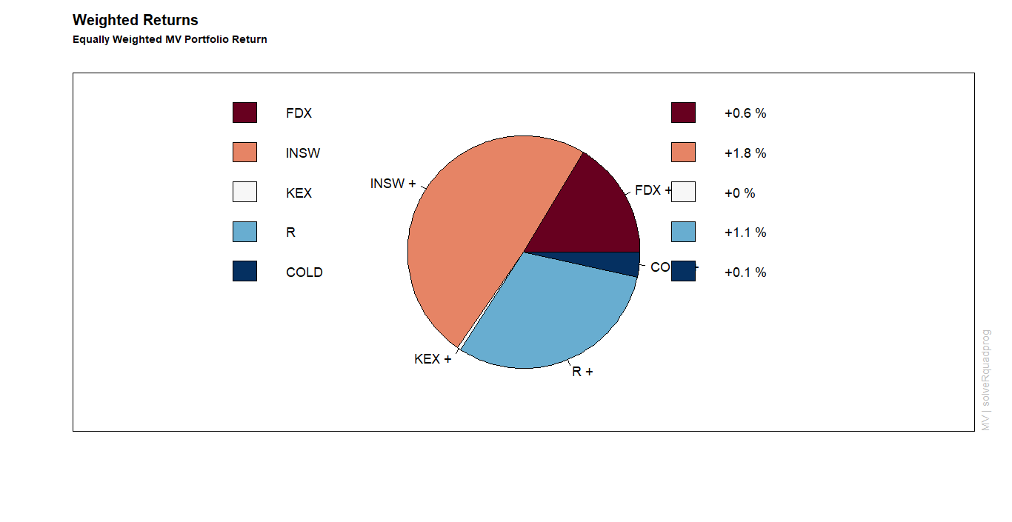
D. Portfolio optimization

Slide 37
D. Portfolio optimization

Slide 38
D. Portfolio optimization
3. Global Minimum Risk Efficient Portfolio
The global minimum variance portfolio is the efficient portfolio with the lowest possible risk.
Target return: 0.0256
Target risk: 1.7011
 | FDX | INSW | KEX | R | COLD
Weights | 0.2008 | 0.1342 | 0.0610 | 0.0834 | 0.5205
Covariance | 0.2008 | 0.1342 | 0.0610 | 0.0834 | 0.5205

Slide 39
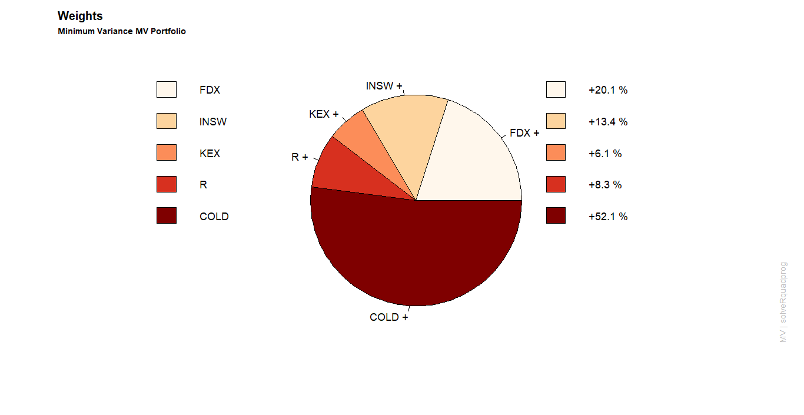
D. Portfolio optimization

Slide 40
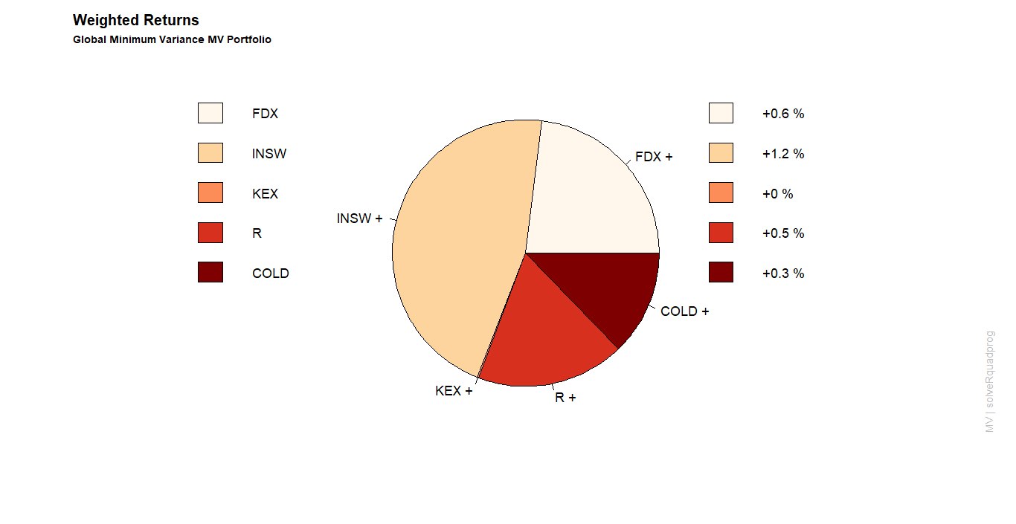
D. Portfolio optimization

Slide 41
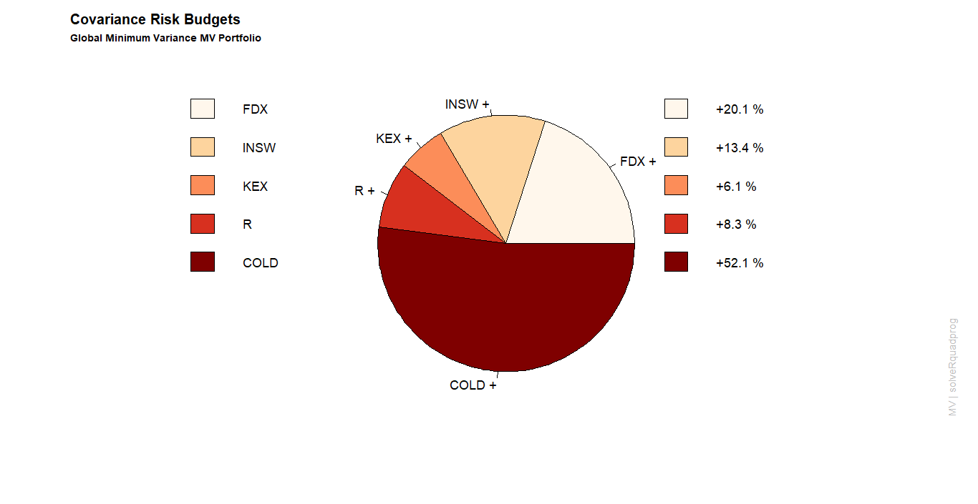
D. Portfolio optimization

Slide 42
D. Portfolio optimization
4. Tangency Portfolio
The tangency portfolio is calculated by minimizing the Sharpe Ratio for a given risk-free rate.
The interest for the US treasury bond in 10 years is 3.48%. Therefore, we take the risk free rate at 3.48%
Target return: 0.0807
Target risk: 2.8615
 | FDX | INSW | KEX | R | COLD
Weights | 0 | 0.7839 | 0 | 0.2161 | 0
Covariance | 0 | 0.9049 | 0 | 0.0951 | 0

Slide 43
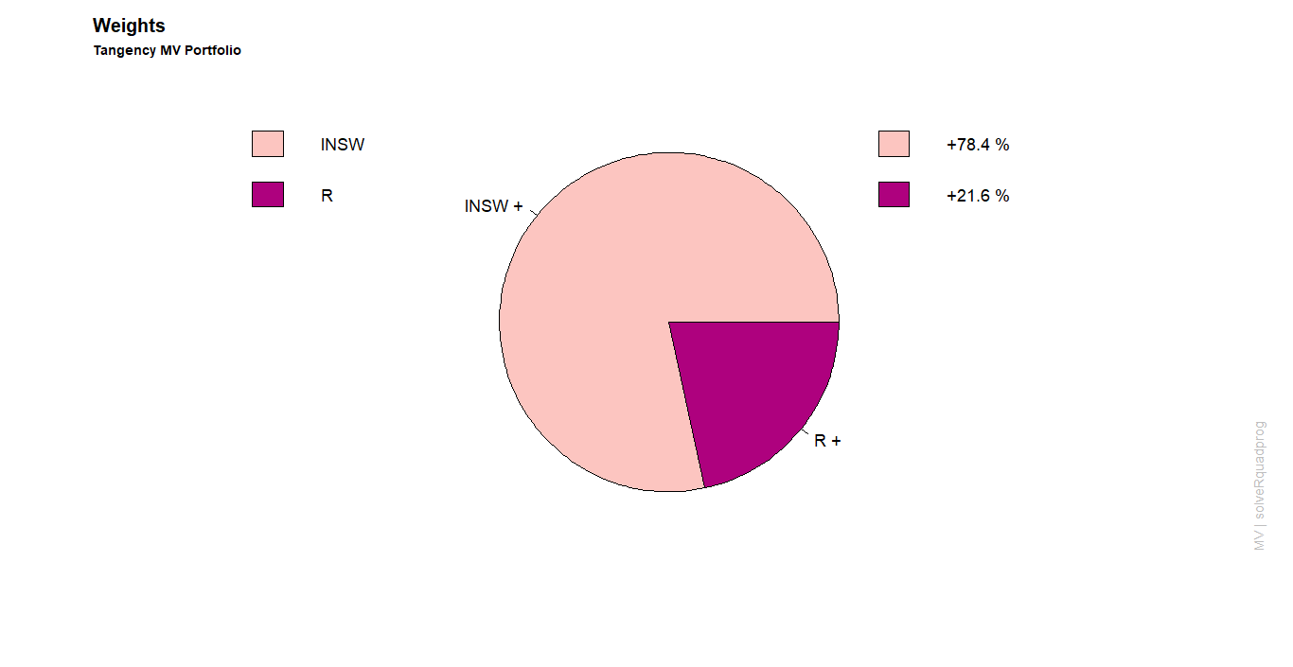
D. Portfolio optimization

Slide 44
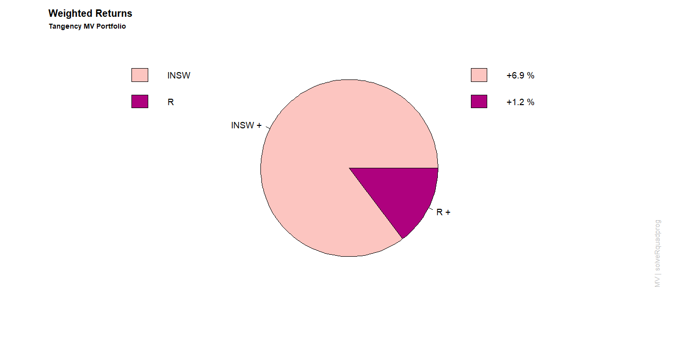
D. Portfolio optimization

Slide 45
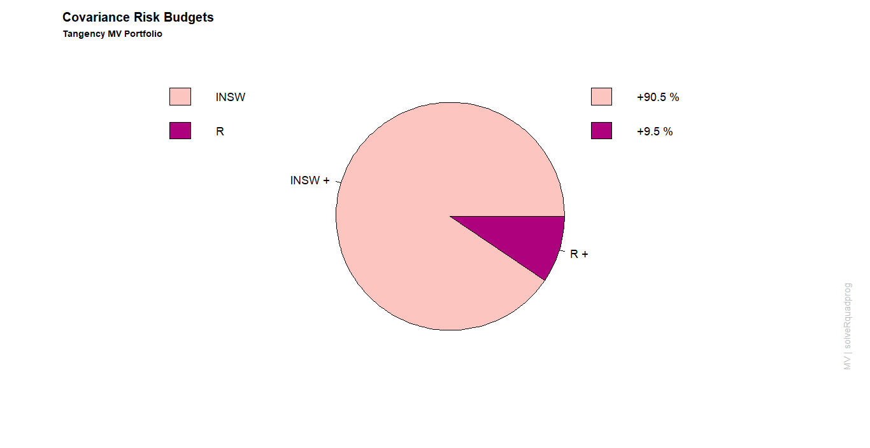
D. Portfolio optimization

Slide 46
D. Portfolio optimization
5. Portfolio efficient Frontier

Slide 47
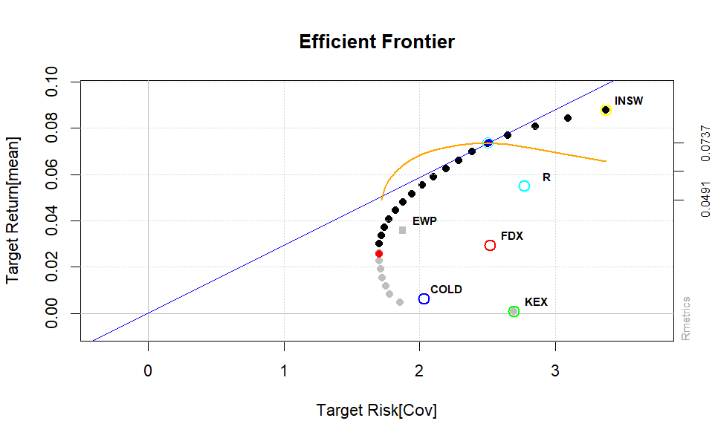

Slide 48
E
Conclusion

Slide 49
E. Conclusion
Most investors– Minimum Variance Port – low risk, low return daily, offset with real world
Some risk tolerance bunch – Max risk, max return with Tangency Port and INSW stock

Slide 50
Thanks!
Do you have any questions

